Slide 1
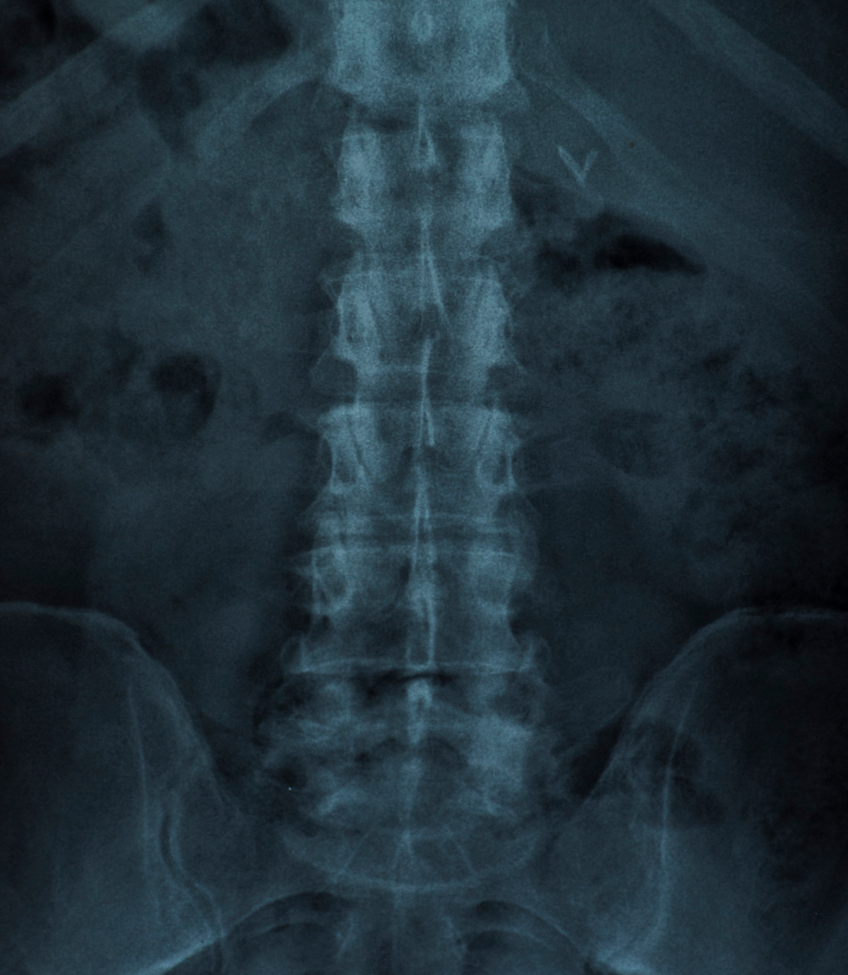
Medical Image Segmentation
By Pritam Channawar Vinay Pusuluri

Slide 2
Table of contents
01
02
03
04
Introduction
Dataset
Architecture
Results

Slide 3
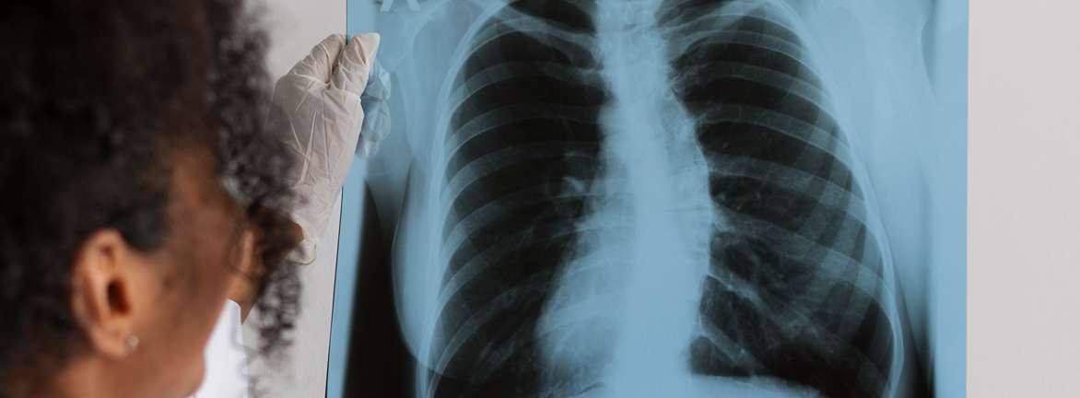
Segmentation
“Division into separate parts or sections” (ROI)

Slide 4
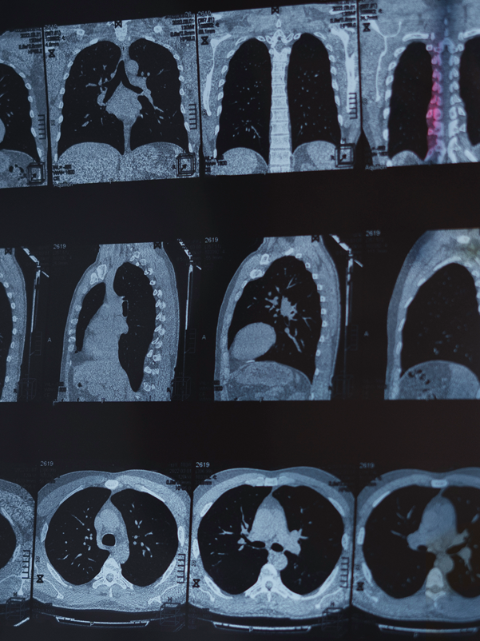
01
Introduction

Slide 5
Medical Image Segmentation
Liver segmentation is an important task in medical imaging because it helps to identify the location and size of the liver in CT and MRI scans, which is essential information for the diagnosis and treatment of various liver diseases.
It plays a vital role in liver cancer diagnosis and treatment planning, as it allows physicians to define the exact location and extent of tumors, which is crucial for determining the best treatment options and assessing treatment response.
Segmentation can be a challenging task, especially when it comes to medical images.
The images can be of varying quality, and the structures of interest can appear differently in different patients.

Slide 6
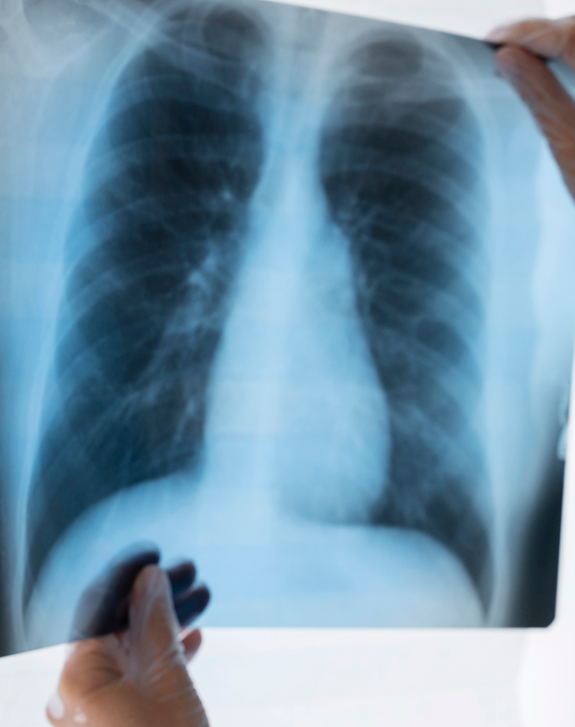
CT Images
The term “computed tomography,” or CT
slices are called tomographic images and can give a clinician more detailed information than conventional x-rays.
Image slices can either be displayed individually or stacked together by the computer to generate a 3D image of the patient that shows the skeleton, organs, and tissues

Slide 7
File format
.nii file
Library
NII files mostly belong to NIfTI-1 Data Format by Neuroimaging Informatics Technology Initiative.
Nibabel
Read and write access to
common neuroimaging
file formats

Slide 8
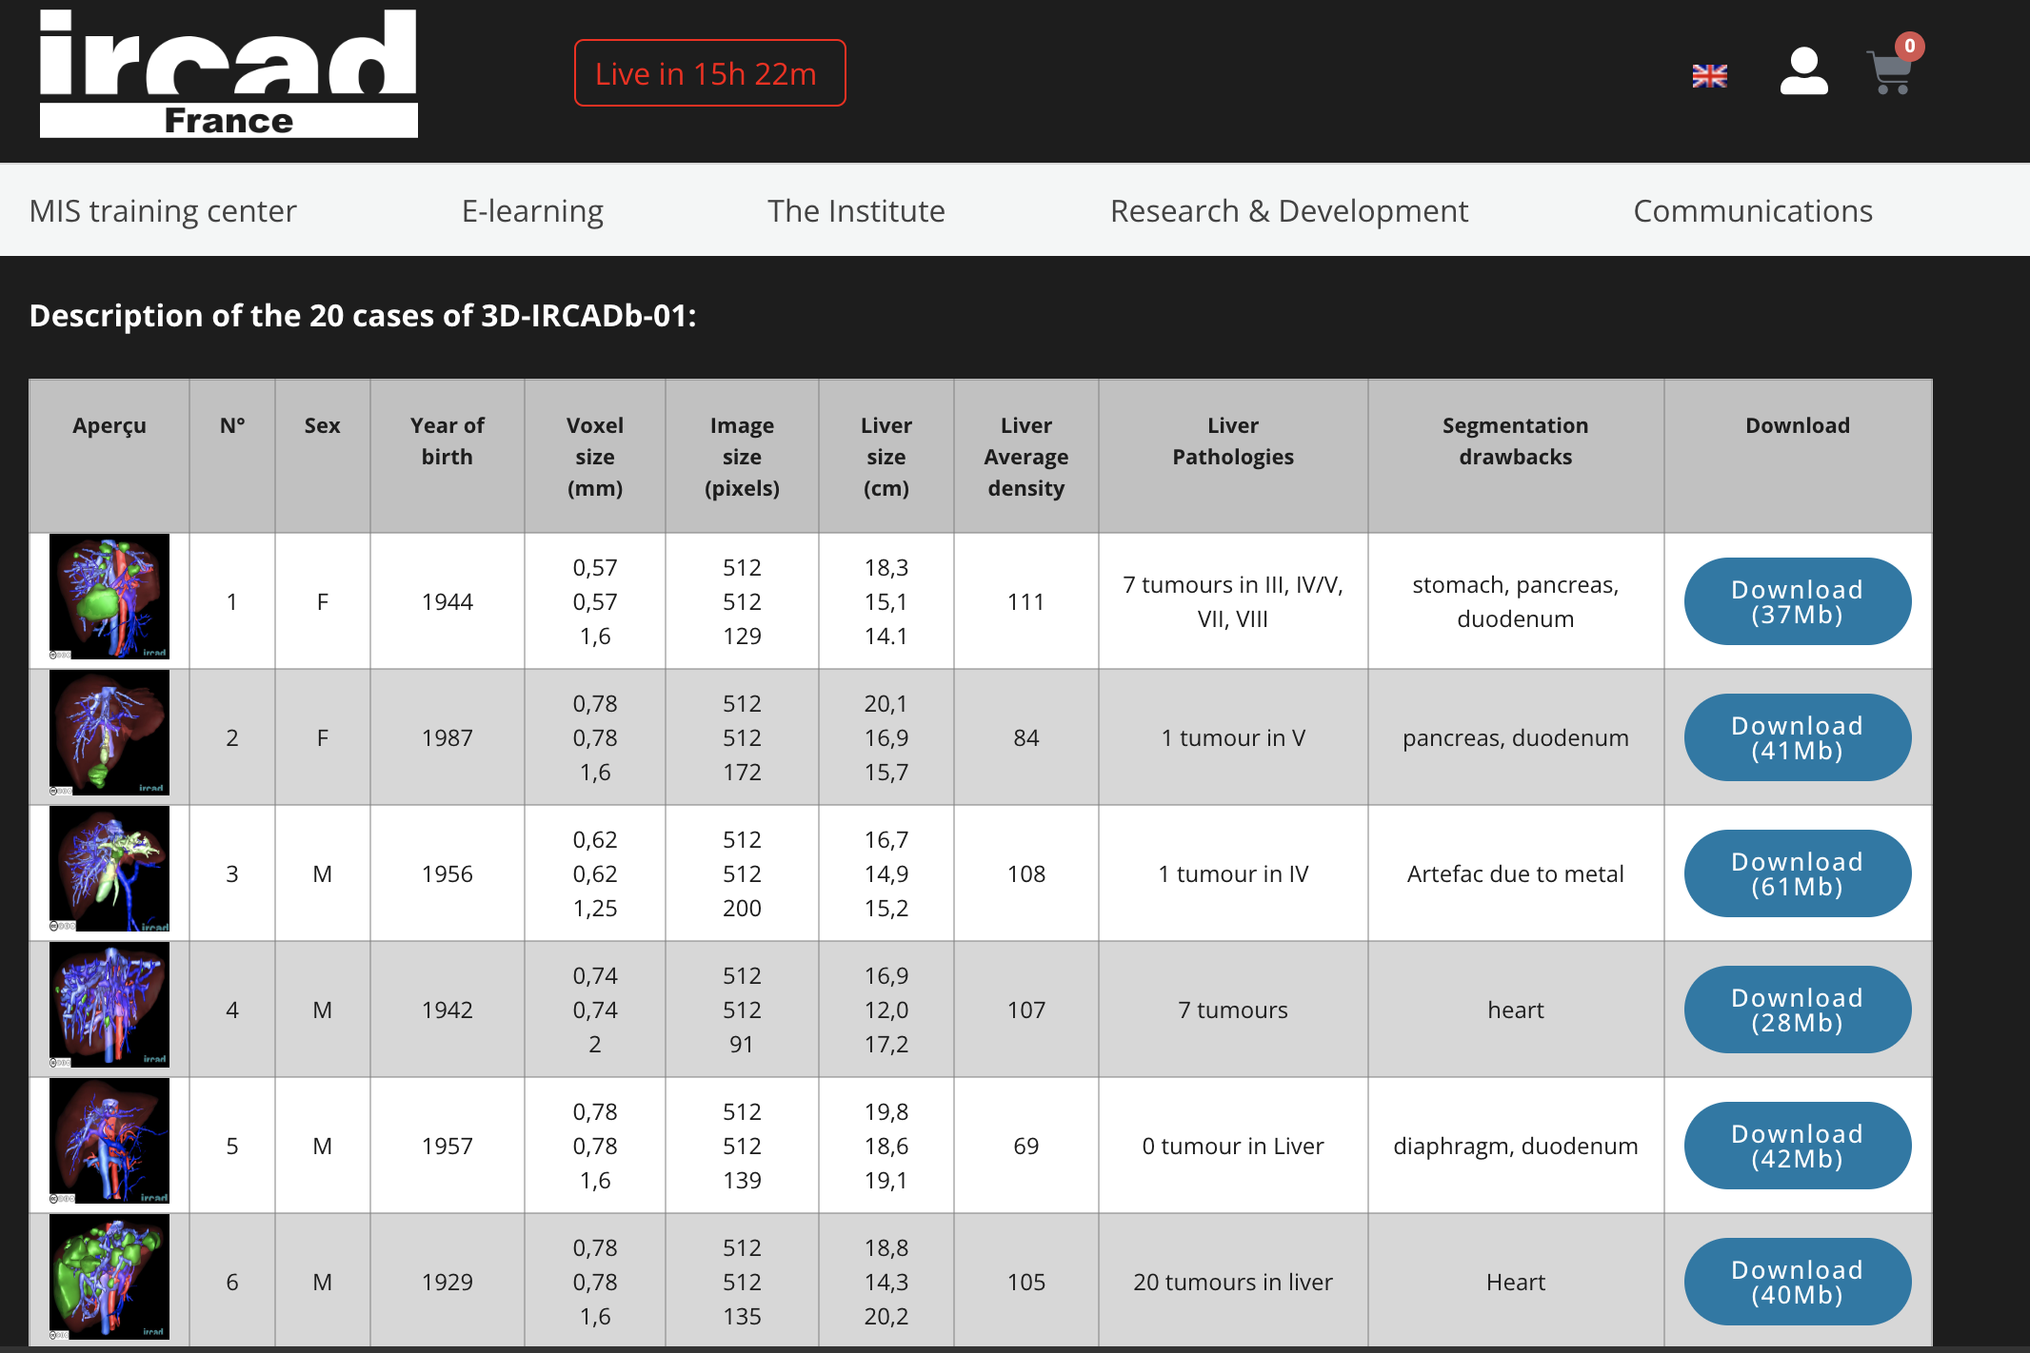
Dataset used
Using a dataset publicly available from the IRCAD research center in France.
The 3D-IRCADb-01 database is composed of the 3D CT-scans of 10 women and 10 men with hepatic tumors in 75% of cases.
The 20 folders correspond to 20 different patients.

Slide 9
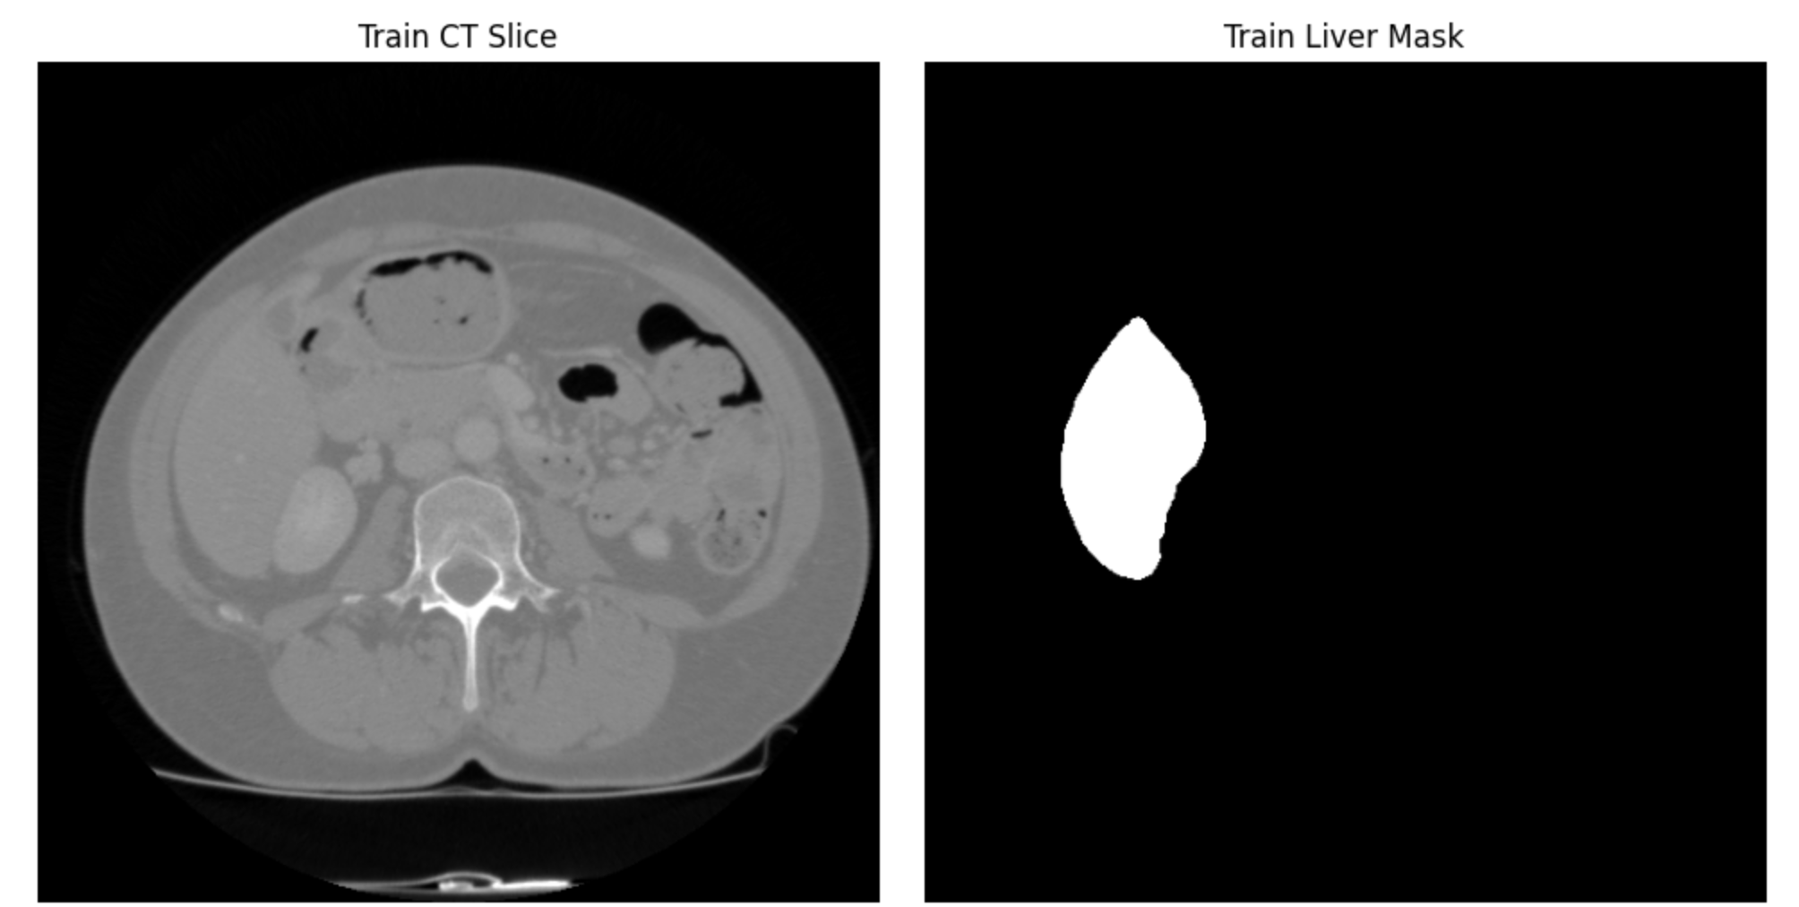
Mask images also known as binary masks or ground truth masks, are images used to define and highlight specific regions or structures of interest within a medical image.
Mask images serve as ground truth data during the training of machine learning models, especially in supervised learning approaches.
The model learns to map the input medical images to the corresponding mask images.

Slide 10
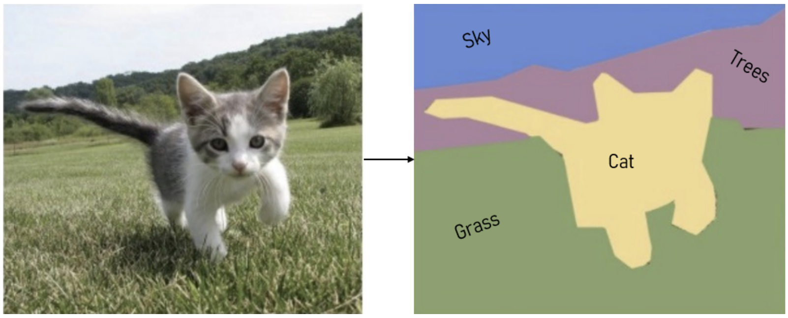
Semantic Segmentation
The goal of Semantic Segmentation is to label each pixel of an image with a corresponding class.

Slide 11
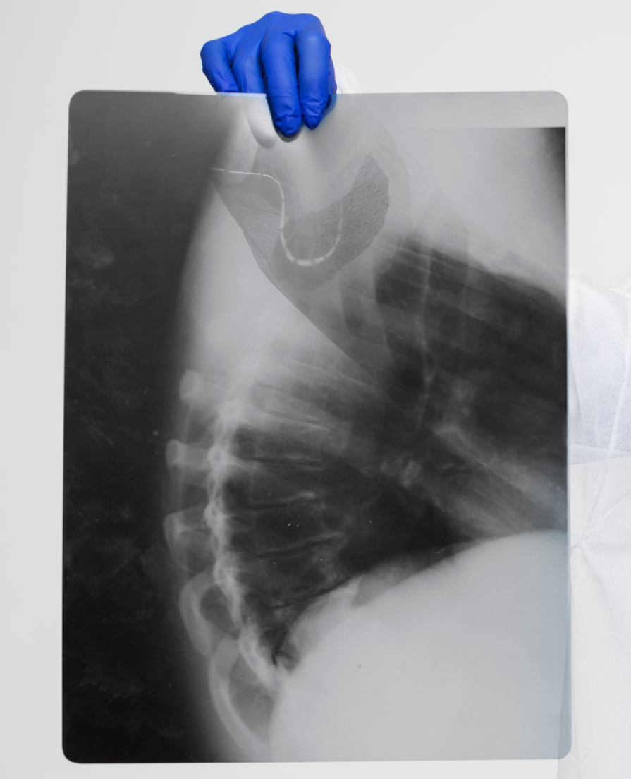
02
Unet Architecture

Slide 12
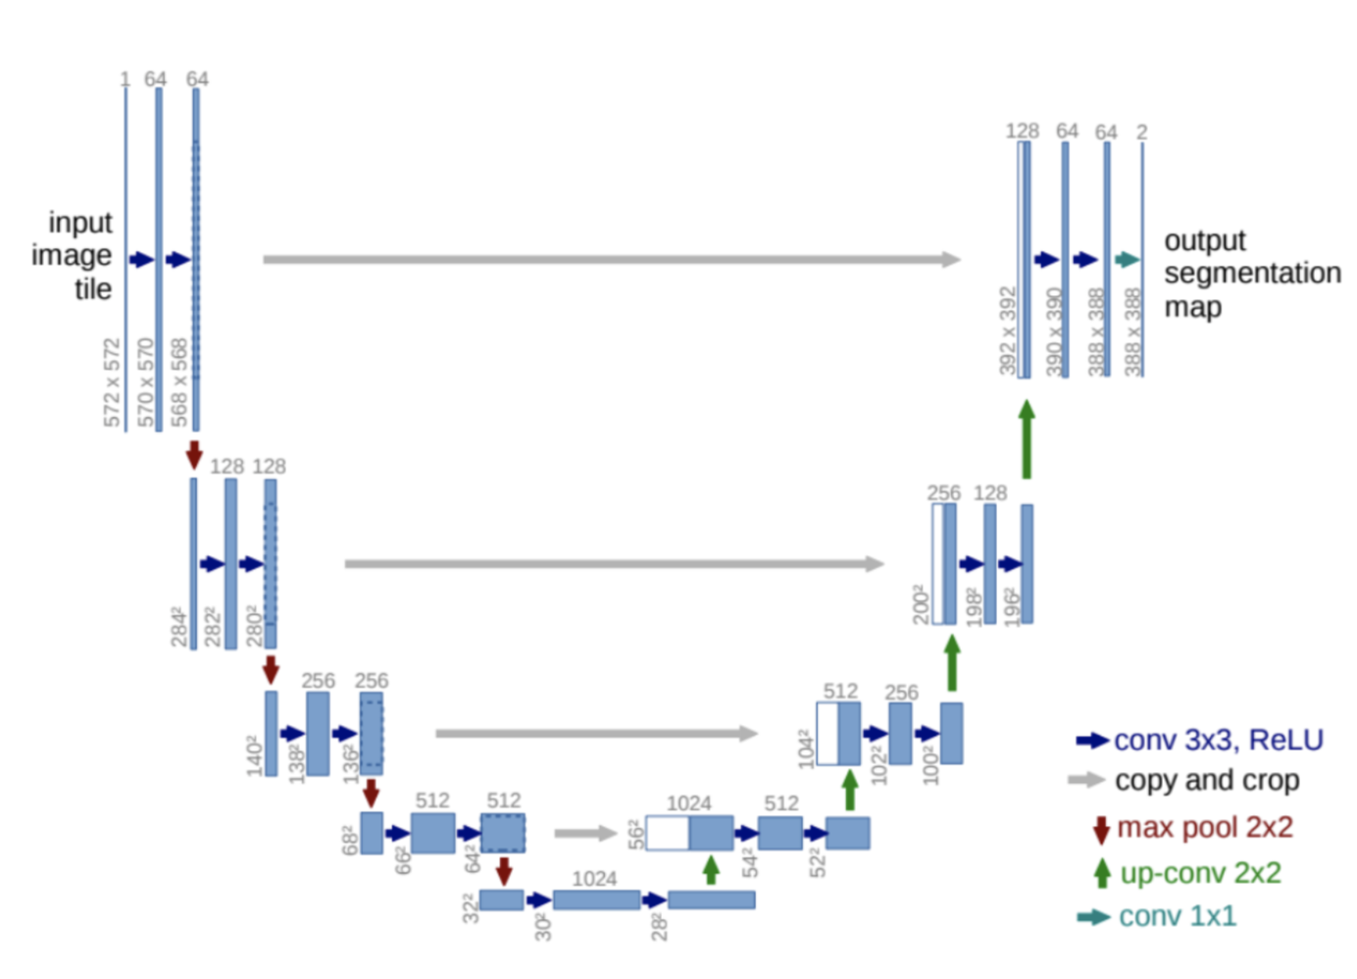
Encoder
Decoder

Slide 13
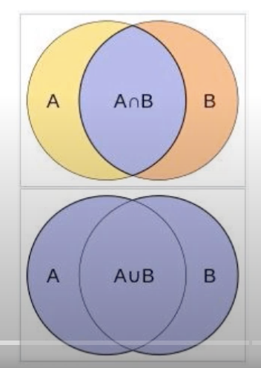
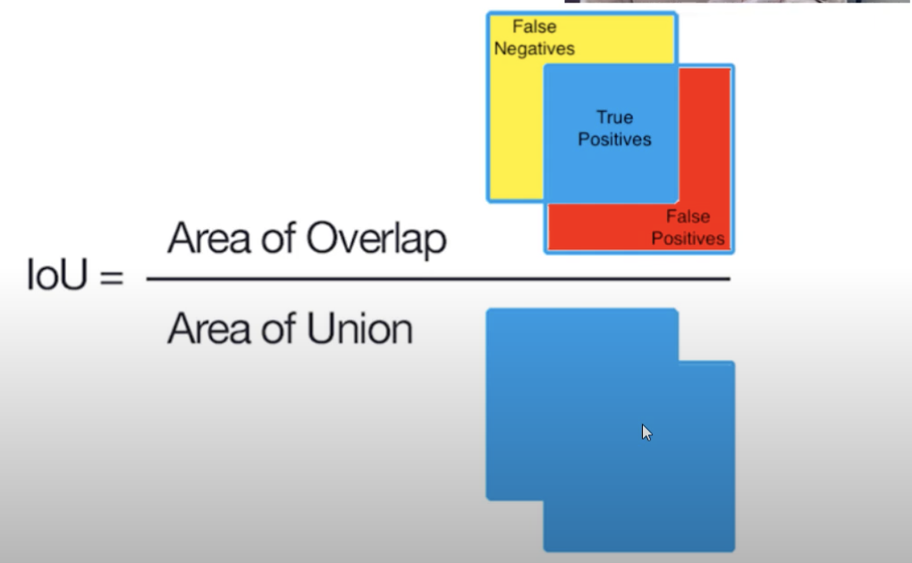
Dice Coefficient
a statistic used to measure the similarity or agreement between two sets, particularly in the context of binary data or image segmentation. It's commonly used in image processing and medical image analysis.
The formula for the Dice coefficient is:
Dice = (2 * |A ∩ B|) / (|A| + |B|)
The Dice coefficient provides a value between 0 and 1, where 0 indicates no overlap between the sets, and 1 indicates a perfect match, or complete overlap.

Slide 14
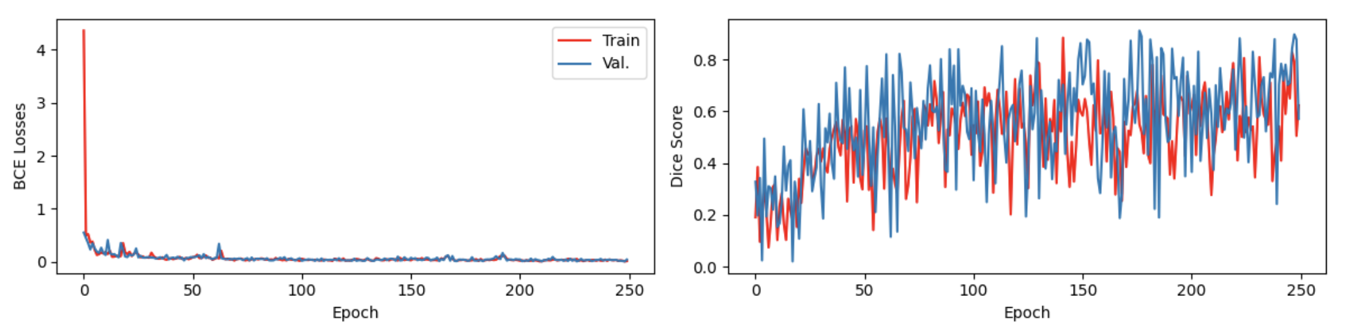
Dice Coefficient and BCE Loss
Best results at epoch = 250, Learning Rate = 1e-3

Slide 15
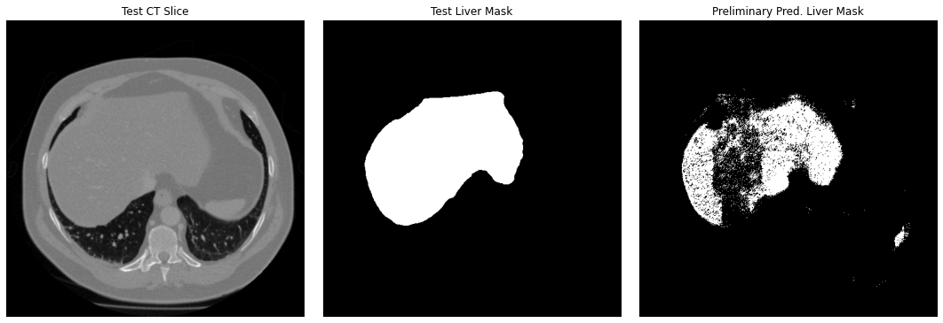
Results

